Slide 1
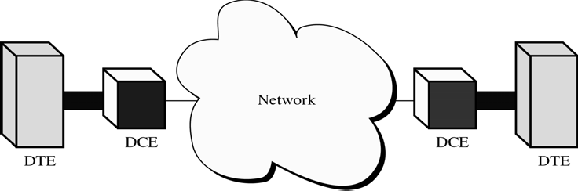
CS601-Data Communication
VU
LECTURE #21
DTE-DCE Interface
There are 4 basic functional units involved in communication of data:
–A DTE and DCE on one end
–A DTE and DCE on the other end
DTE: Any device that is a source of or destination of digital data
DCE: Any device that transmits/receives signal through network
The DTE generates the data and passes it along with any control information to a DCE
The DCE converts the signal to a format appropriate to the TX medium and introduces it onto the network link
When the signal arrives at the receiving end this process is reversed
DTE
DTE includes any unit that functions either as a source of or as a destination for binary digital data
At the physical layer, it cab a terminal, microcomputer, computer , printer or any other device that generates or consumes digital data
DTEs do not often communicate with each other directly with each other
Think of DTE as your Brain.
Your and your friends brains are DTEs
The vocal chords or mouth are DCEs
Air is TX Meduium
DCE
DCE includes any functional unit that transmits or receives data in the form of an analog or digital signal through a network
At the physical layer, a DCE takes data generated by a DTE, converts it to the appropriate signal and then introduces it to the comm link
Commonly used DCEs at the physical layer include MODEMS

Slide 2
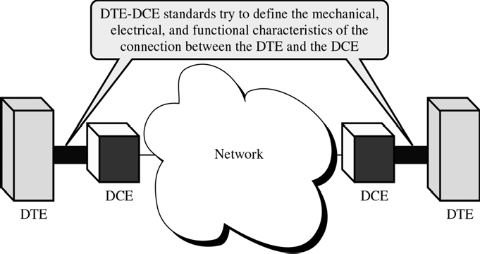
CS601-Data Communication
VU
In any n/w , a DTE generates digital data and passes it on to a DCE, the DCE converts the data to a form acceptable to the TX medium and sends the converted signal to another DCE on the network
The second DCE takes the signal off, converts it to a suitable form for its DTE and delivers it
To make this communication possible, the sending and receiving DCEs must use the same modulation method
*The two DTEs need not be coordinated with each other but they need to be coordinated with their respective DCEs and the DCEs must be coordinated so that data translation occurs w/o loss of integrity
Standards
Many standards have been developed to define the connection b/w the DTE and a DCE
Though the solution differ, each standard provides a model for mechanical, electrical and functional characteristics of the connection
Electronic Industries Organization (EIA) and ITU-T
EIA 232 Interface
Standard developed by EIA
Defines Mechanical, Electrical and Functional characteristics of the interface b/w DTE and a DCE
Originally issued in 1962 as the RS 232 standard
Revised several times, recent version EIA 232-D
Defines not only the type of connectors to be used but also the specific cable and plugs and the functionality of each pin
Mechanical Specifications
EIA 232 standard defines interface as a 25-wire cable with a male and a female DB 25 pin connector attached to either end.
The length of the cable may not exceed 15 meters(50 feet)
A DB 25 connector is a plug with 25 pin or receptacles each of which is attached to a single wire with a specific function
With this design, EIA has created the possibility of 25 separate interactions b/w a DTE and a DCE
Fewer are actually used but standard allows for future inclusion of functions

Slide 3
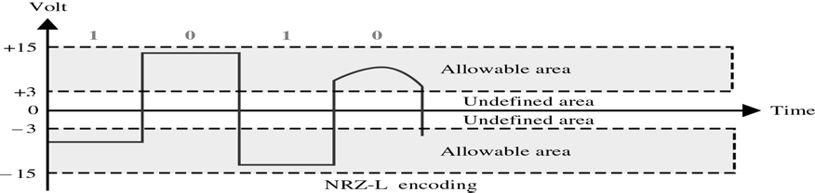
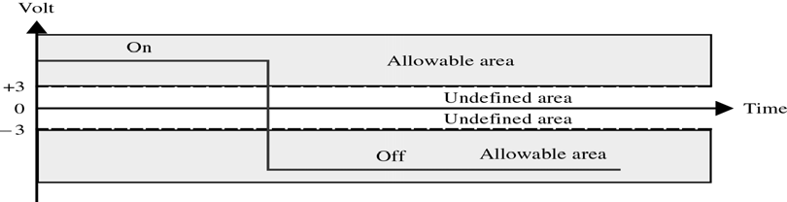
CS601-Data Communication
VU
EIA 232 calls for a 25 wire cable terminated at one end by by a male connector and at the other end by a female connector
Male refers to a plug with each wire in the cable attaching to a pin
Female refers to a receptacle with each wire in cable connecting to a metal tube or sheath
Electrical Specifications (Sending data)
EIA 232 states that data must be tx as binary 1’s and 0’s using NRZ-L encoding with 0 defines as a positive and 1 defined as a negative voltage
However rather than defining a single range bounded by highest and lowest amplitudes, EIA 232 defines two distinct ranges , one for +ve voltages and one for -ve
The receiver accepts any voltage that falls within these ranges as valid signals
To be recognized as data, the amplitude of the signal must fall b/w 3 and 15 volts or b/w –3 and –15 volts
Degradation of noise will in misinterpretation of bits
A square wave is shown to be converted into a curve by noise and it covers many voltages
If the rx were looking for a fixed voltage, or only for pulses that held a single voltage for their entire duration,degradation would have made it unrecoverable.
Electrical Specifications (Control & Timing)
Only 4 wires out of 25 in EIA 232 are used for data functions.
Remaining 21 are reserved for functions like Control, Timing,
Grounding and Testing
Any of the functions is considered ON if it transmits a voltage of atleast +3 and OFF if it tx a voltage with a value less than -3
The specification for control signals is conceptually reversed from that for data transmission
A positive voltage means ON and a negative voltage means OFF

Slide 4
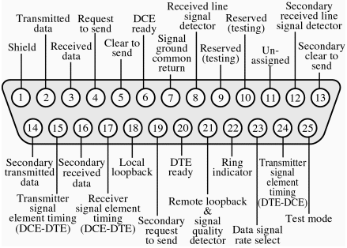
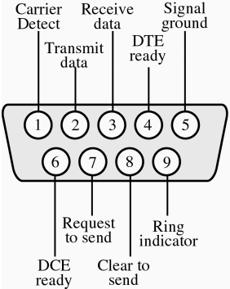
CS601-Data Communication
VU
Electrical Specifications (BIT rate)
A final important function of electrical specifications is definition
of Bit Rate
EIA 232 allows for a maximum bit rate of 20Kbps although in practice it is often is exceeded
Functional Specifications
Two different implementations of EIA 232 are available:
–DB 25
–DB 9
DB 25 connector defines the functions assigned to each of the 25 pins in the DB 25 connector
Functional Specifications
Figure shows the ordering and functionality of each pin of a male connector
Female connector will be a mirror image of the male so that pin 1 in the plug matches tube 1 in the receptacle and so on
Each comm function has a mirror or answering function for traffic in the opposite direction to allow for full duplex operation
For Example, pin 2 is for transmitting data and pin 3 is for receiving data
Pin 9 and 10 are for future use
Pin 11 is yet unassigned
DB9 IMPLEMENTATION
Most of the pins in DB 25 implementation are not necessary ina single asynchronous connection
A simpler 9 pin version of EIA 232 is shown in the figure
Functioning Steps
*Step 1: Preparation

Slide 5
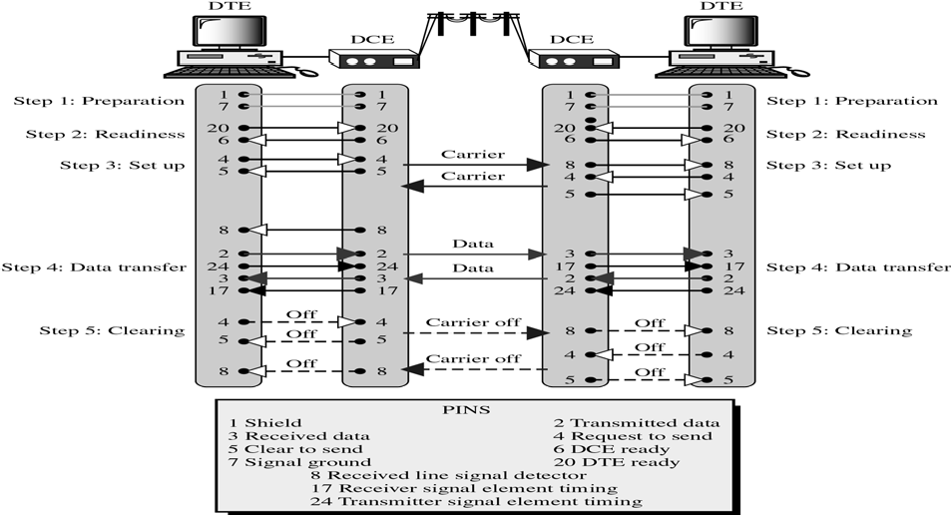
CS601-Data Communication
VU
–Preparation of the interface between DTE and DCE
*Step 2: Readiness
–Checks if all four devices are ready
*Step 3: Set up
–Set up the connection between two DCEs
*Step 4: Data Transfer
–DTE -> DCE -> DCE -> DTE
*Step 5: Clearing
–Turning OFF the connection
Functioning Example
Step1: Preparation of interfaces for TX. The two grounding circuits,1(shield) and 7 (ground) are active b/w the two devices
Step 2 ensures that all four devices are ready for TX. First the sending DTE activates pin 20 and sends a Dte ready message to its DCE . DCE answers by activating pin6 .
Same sequence is performed by remote computer
Step3: sets up the physical connection b/w the sending and the receiving modems.
First the DTE activates pin 4 and sends its DCE a request to send message. The DCE transmits a carrier signal to the idle receiving modem
When receiving modem detects the carrier signal, it activates pin 8, telling its computer that a TX is about to begin .
After tx the carrier signal, sending DCE activates pin 5 sending its DTE a clear to send message. The remote computer and modem do the same step
Step4: Data transfer procedure
Initiating computer transfers its data stream to its modem over circuit 2accompanied by the timing pulse of circuit 24.
Modem converts digital data to an analog signal and sends it over the network
Responding modem retreives the signal, converts it back to digital and passes it to DTE via circuit 3 and timing pulse of 17
Step5: Once both computers have completed their transmission, both computers deactivate their request-to-send circuits , modems turn off their carrier signals, their received line signal detectors and their clear to send circuits

Slide 6
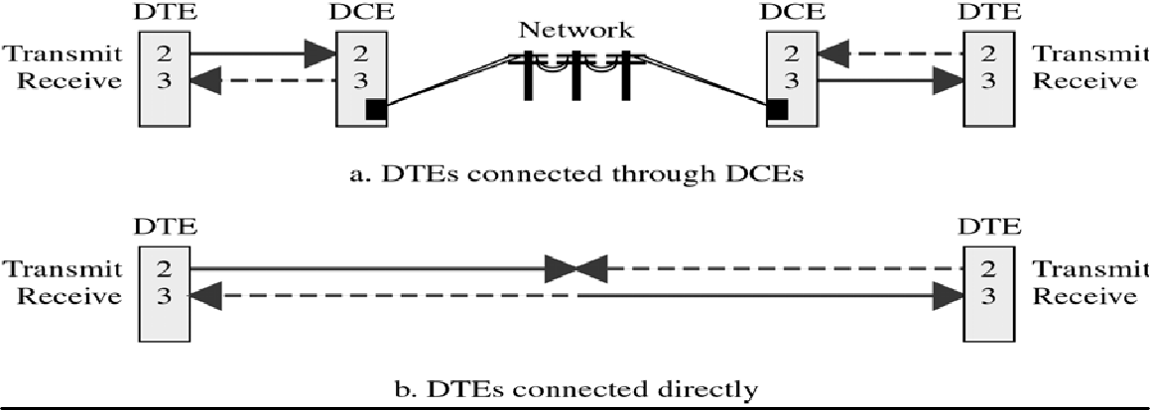
CS601-Data Communication
VU
NULL MODEM
Suppose you need to connect two DTEs in the same building, for example two workstations
Modems are not needed to connect two compatible devices directly
The TX never needs to cross analog lines, such as telephone lines and therefore does not need to be modulated
But you do need an interface to handle the exchanging , just as EIA 232 DTE-
DCE cable does
The solution is a NULL Modem
A null modem provide DTA –DTE interface w/o DCEs
But why use a Null Modem
If all you need is the interface, why not just a a standard EIA 232 cable?
Part a shows a connection using a telephone network
Part b shows what happens when we use the same connections between two DTEs
The receive circuit is void because it has been isolated completely for the TX
The tx cct 2 endsup full of collision noise
NULL MODEM Crossing Connections
Whereas EIA 232 DTE-DCE interface cable has a female connector at the DTE and a male connector at the DCE end, a null modem has female connectors at both ends to allow it to connect to the EIA 232 DTE ports which a male

Slide 7
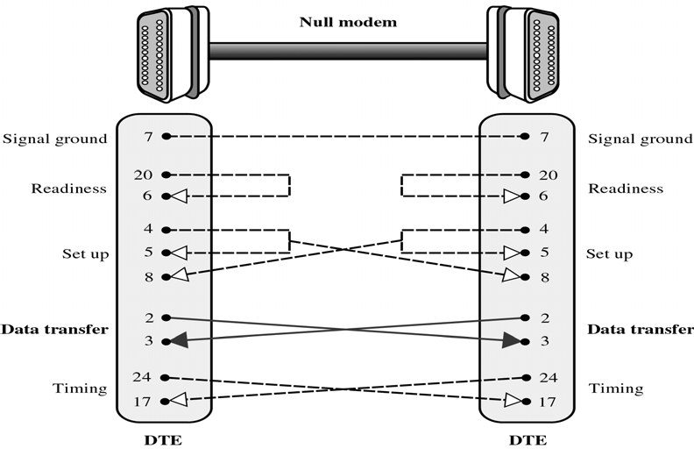
CS601-Data Communication
VU
Summary
*DTE-DCE Interface
*DTE-DCE Interface Standards
*EIA-232
*Null Modem
Reading Sections
Section 6.2,6.3, “Data Communications and Networking” 4th Edition by Behrouz A. Forouzan

Slide 8
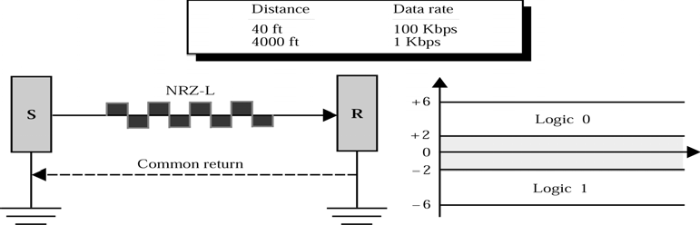
CS601-Data Communication
VU
LECTURE #22
Other Interface Standards
Both Data Rate and Cable LENGTH are restricted by EIA 232
Data rate to 20 Kbps and Cable length to 50 feet
To meet need of users requiring more speed or distance , the EIA and ITU-T has introduces additional standards: EIA 49, EIA 530 and X.21
EIA 449
Mechanical specifications of EIA 448 define a combination of two connectors , on with 37 pins ( DB 37) and one with 9 pins (DB 9) for a combined 46 pins
The functional specifications of EIA 449 give the DB 37 pins properties similar to those of the DB 25.
The major functional difference b/w 25 and 37 pin connectors is that all functions
relating to the secondary channel have been removed from DB 37
Because the secondary channel is seldom used, EIA 449 separates those functions out and puts them in the second, 9 pin connector (DB9)
In this way, a second channel is available to systems that need it
EIA 449 (PINS)
To maintain compatibility with EIA 232, EIA 449 defines two categories of pins to be used in exchanging data, control, and timing information
Category 1 pins
Category 2 pns
Category 1 and 2 pins
Category 1 includes those pins whose functions are compatible with EIA 232
Category 2 pins are those that have no equivalent in EIA 232 or have been redefined
DB9 connector here is different from the one that is previously discussed
Electrical Specifications RS423, RS 422
EIA 449 uses two standards to define its electrical specifications:
RS-423: Unbalanced Mode
RS-422: Balanced Mode
RS 423 Unbalanced Mode
Unbalanced Circuit Specification
Unbalanced means that it defines only one line for propagating a signal
All signals in this standard use a common return or a ground to complete the circuit

Slide 9
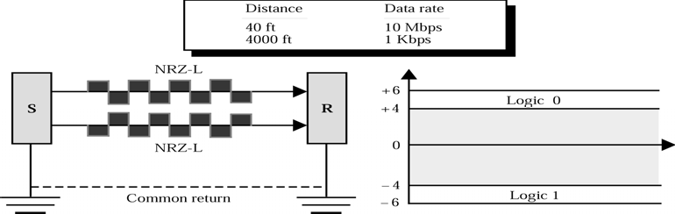
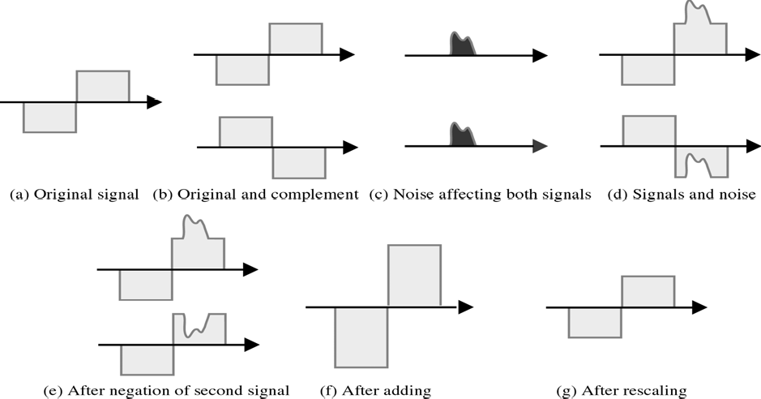
CS601-Data Communication
VU
o In unbalanced mode, EIA 449 calls for the use of only the first pin of each pair of category 1 pins and all category 2 pins
RS 422 Balanced Mode
Balanced circuit specification
Defines two lines for the propagation of each signal
Signal again uses a common return
EIA utilizes all pairs of pins in category 1 but does not use the category 2 pins
The ration of data rate to distance is much higher in this case than EIA 232
In balanced mode two lines carry same signal which are not identical to each other
Signal on one line is the complement of the other
Canceling of Noise in the Balanced Mode
When plotted, complement of the signal looks like the mirror image of the signal
EIA 530

Slide 10
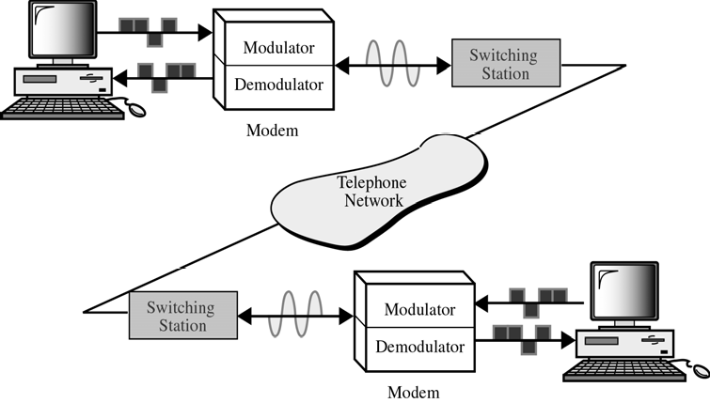
CS601-Data Communication
VU
EIA 449 provides much better functionality than EIA 232
However it requires a DB 37 connector that industry has been reluctant to use because of the widespread use of DB 25
To encourage acceptance of EIA 449, EIA developed a version of EIA- 449 that uses DB 25 pins
Pin functions of EIA 530 are essentially those of EIA 449 CATEGORY 1 pins plus three pins from category 2
EIA 530 does not support a secondary circuit
❖ X.21
Eliminates most of control pins of EIA standards
–Control signals are encoded to control characters
–Send control characters within the data line
–More control information for digital telephony
For digital communication between devices over a network, rather than just between DTE and DCE
DB-15, Work with balanced circuits at 64Kbps
MODEMS
Most familiar type of a DCE
We require modem to connect to the internet
MODEM is a composite word for modulator and Demodulator
Modulator converts a digital signal into an analog signal using ASK, FSK,
PSK or QAM
A demodulator converts an analog signal into a digital signal
While a demodulator resembles an analog-to-digital converter, it is not infact a converter of any kind
It does not sample the signal to create a digital signal
It just reverses the process of modulation that is it performs demodulation
Shows the relationship of a modulator with a demodulator
Two PCs at the end are DTEs, and the modems are the DCEs
110

Slide 11
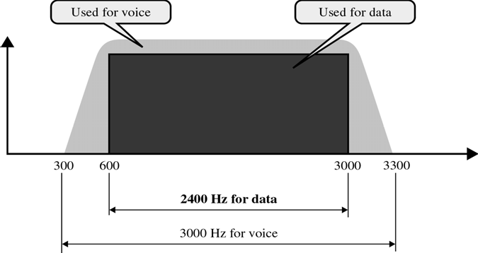
CS601-Data Communication
VU
DTE creates a digital signal and relays it to the Modem via an interface via an interface
Modulated signal is received by the demodulation function of the second modem
This modem takes this ASK, FSK, PSK or QAM signal and decodes it into whatever format its computer can accept
It then relays the digital signal to the computer via an interface
Each DCE must be compatible with both its own DTE and the other DCE
Transmission Rate
Modems are often described as high speed or low speed to indicate how many bits per second a specific device is capable of transmitting or receiving
Limitations on the transmission rate of the Modem
Bandwidth
Data rate of a link depends upon the type of encoding uses and the bandwidth of the medium
The medium bandwidth is related to the inherent limitation of the physical property of the medium
Every line has a range of frequencies it can pass
If the frequency of a signal is too ow, it cannot overcome the capacitance of the line
If frequency is too high, it can be impeded by the inductance of the line
So every line has an upper limit and a lower limit on frequencies of the signals
This limited range is called Bandwidth
Telephone Line Bandwidth
Traditional telephone lines can carry fre’s b/w 300 Hz and 3300 Hz giving them a BW of 3000Hz
All of this range is used for transmitting voice where a great deal of interference and distortion can be accepted w/o any loss of intelligibility
Data signal require a high degree of accuracy , so edges of this range are not used for data comm
Effective BW of telephone line used for data transmission is 2400 Hz covering a range from 600 Hz to 3000Hz
Modem Speed
o Each type of Analog conversion manipulates signal differently:

Slide 12
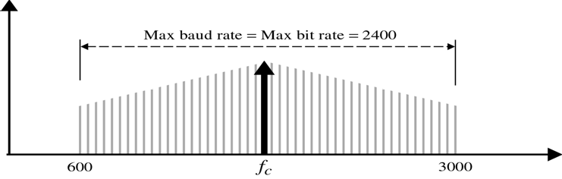
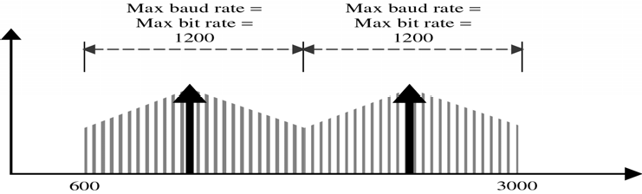
CS601-Data Communication
VU
ASK manipulated Amplitude
FSK manipulates Frequency
PSK manipulates Phase
QAM manipulate both phase and amplitude
Modem Speed-ASK
BW required for ASK is equal to the baud rate of the signal
Assuming that entire link is being used by one signal, as in Simplex or Half Duplex, the maximum baud rate for ASK modulation is equal to the entire BW of the transmission medium
Because the effective BW of a telephone line IS 2400 Hz, the maximum baud rate is also 2400
Baud rate and bit rate are equal for ASK, so maximum bit rate is also 2400 bps
Modem Speed-ASK (Full Duplex)
For full duplex TX, only half of the total bandwidth cab be used in either directions
Therefore the maximum speed for ASK in full duplex mode is 1200 bps
Noise problem makes it impractical for use in Modems
Modem Speed-FSK
BW required for FSK is equal to the baud rate of the signal plus the frequency shift
So maximum baud rate becomes equal to the BW transmission medium minus the frequency shift

Slide 13
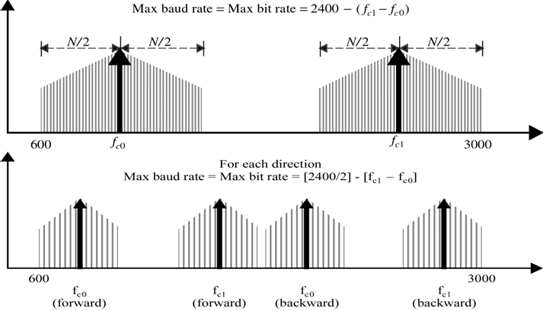
CS601-Data Communication
VU
Maximum Baud rate is therefore 2400 minus the frequency shift
And bit rate is also 2400 minus frequency shift
In full duplex mode it is equal to 1200 minus the frequency shift
Modem Speed-PSK & QAM
Minimum BW for PSK or QAM is the same as for ASK but the bit rate can be greater depending upon the number of bits that can be represented by each signal unit
Modem Speed-PSK & QAM on two wire Twisted pair Telephone line Comparisons of bit rates: HDX and FDX
 | 2-PSK | 2400 | 1200
 | 4-PSK,4-QAM | 4800 | 2400
 | 8-PSK,8-QAM | 7200 | 3600
 | 16-QAM | 9600 | 4800
 | 32-QAM | 12000 | 6000
Summary
* EIA-449
* EIA-530
* X.21
Modems
Reading Sections
Section 6.4, 6.5, “Data Communications and Networking” 4th Edition by Behrouz
Forouzan

Slide 14
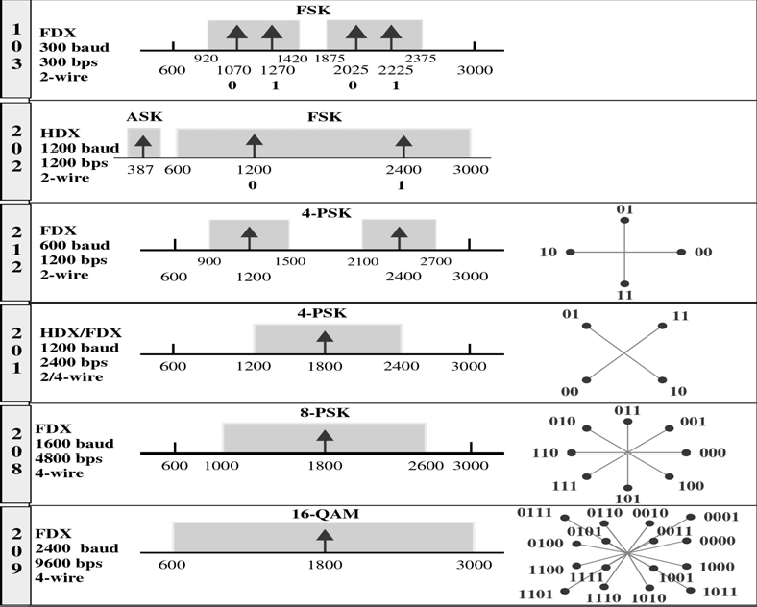
CS601-Data Communication
VU
LECTURE #23
Modem Standards
Bell modems
–First commercial modems by Bell Telephone Co.
–Developed in early 1970s
ITU-T modem standards
–V-series: Today’s most popular modem standards
–Bell modem compatible: V.21/22/23/26/27/29
Intelligent modems
–Hayes (or Hayes-compatible) modems
–Modem is controlled by instructions (AT commands)
–Automatic answering, dialing, etc.
BELL Modems

Slide 15
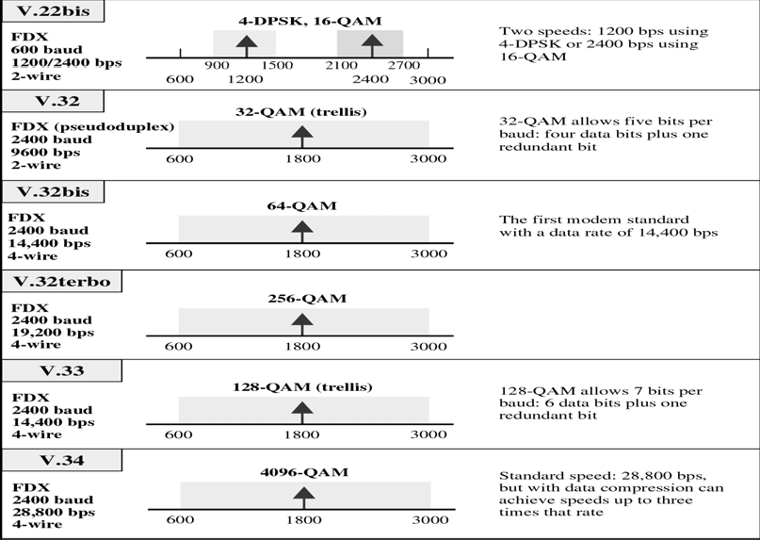
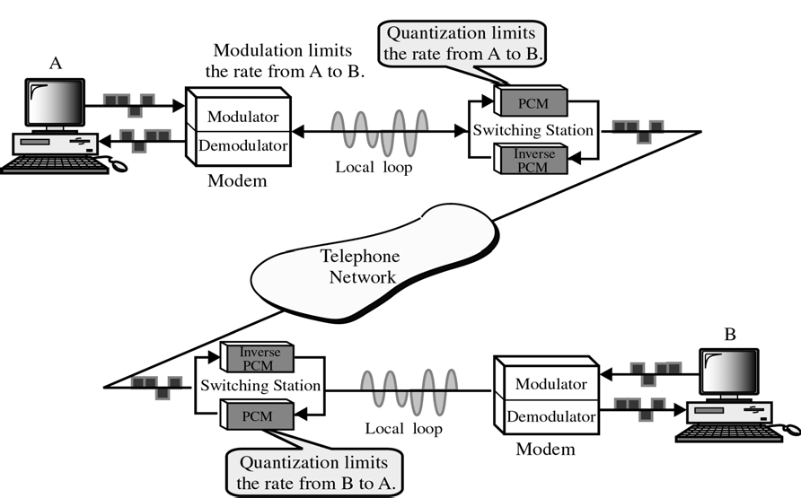
CS601-Data Communication
VU
ITU-T Modems
Traditional Modems
Traditional modems are limited to a data rate of 33.6 Kbps as determined by
Shannon’s formula Data rate ∝ Signal-to-noise ratio
New modems with bit rated of 56 Kbps are wide spread now
TX of data from A to B
Digital data is modulated by the modem at site A
Analog data is sent from the modem to to the switching station at site A using the local loop

Slide 16
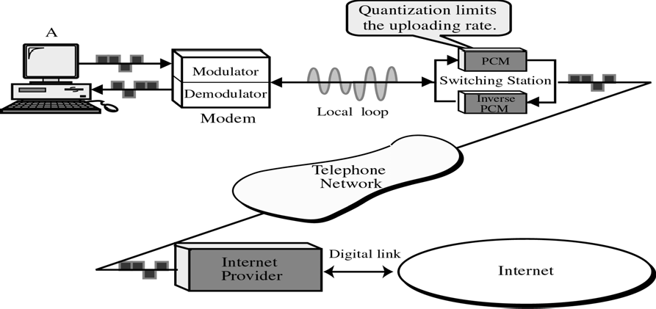
CS601-Data Communication VU
At the switching station, analog data is converted digital using PCM
Digital data travels through the digital network of telephone company and arrives at the switching station of site B
At the switching station , digital data is converted to analog using inverse PCM
Analog data is sent from switching station at site B to the modem using the local loop
Analog data is demodulated by modem at site B
The limiting factor is step 3. Here the analog signal is quantized to create digital signal. The quantization noise resulting from this process limits the data rate to 33.6 Kbps
The TX of data from site B to site A follows the same steps and again the limiting factor is quantization.
*RESULT:
The maximum data rate in each direction is limited to 33.6 Kbps
56K Modems
If one side is an ISP and the signal does not have to pass through a PCM converter , quantization is eliminated in one direction and data rate can be increased to 56 Kbps
Uploading
Transmission of data from the subscriber to the ISP(UPLOADING) follows the following steps:
Digital data is modulated by Modem at site A
Analog data is sent from the modem to the switching station at site A on the local loop
At the switching station, data is converted to digital signal using PCM
Digital data travel through the digital network of the telephone network of the telephone company and is received by the ISP computer
The limiting factor is again step 3
However user does not need high data rate since in this direction only small blocks of data is sent
DOWNLOADING

Slide 17
CS601-Data Communication
VU
Tx of data from ISP to the modem at site A follows these steps:
Digital data is sent by the computer of ISP through the digital telephone network
At the switching station, digital data is converted to analog using inverse PCM
Analog data is sent from the switching station at site A to the modem on the local loop
Analog data is demodulated by modem at site A
Note that in this direction there is no quantization of data using PCM.
The limitation when uploading is not an issue an here a
Data can be sent at 56 Kbps
This is what user is looking for since larger files are typically downloaded from internet
*RESULT
The maximum data rate in the uploading direction is still 33.6 Kbps but the data rate in downloading direction is now 56 Kbps
Why 56Kbps?
–Switching stations of the telephone company use PCM/Inverse PCM for digitizing voice
–8000 samples/sec * 7 bits/sample = 56 Kbps
Summary
*MODEM Standards
–Bell Modems
–ITU-T Modems
*Traditional MODEMS
*56k MODEMs
*Cable Modems
Reading Sections
*Section 6.4, 6.5, 6.6,“Data Communications and Networking” 4th Edition by Behrouz A. Forouzan

Slide 18
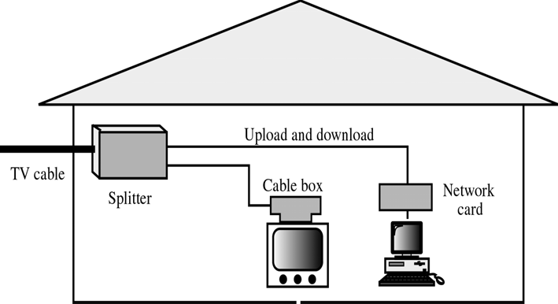
CS601-Data Communication
VU
LECTURE #24
Cable Modems
Data rate limitation of traditional modems is mostly due to the narrow BW of the local loop telephone line (4Khz)
If higher BWs are available, one can design a modem that can handle much higher data rates
Fortunately, cable TV provides residential premises with a coaxial cable that has a BW of up to 750 MHz and sometimes even more
This BW is normally divided into 6MHz bands using FDM
Each band provides a TV Channel
Two bands can be left aside to allow a user to download and upload the information from the internet
Instead of the traditional cable box, we show a splitter
The splitter directs the TV bands to the TV set and the Internet access bands to the PC
DOWNLOADING: Downloading requires a 6 MHz BW in the range above 40MHz. The demodulation technique used is 64 QAM (6 bits at a time)
This means that a user can download info at a rate of 6MHz * 6 = 36Mbps
However PCs are not yet capable of receiving data at this rate
Currently rate is b/w 3 and 10 Mbps
UPLOADING: Requires a 6MHz BW in a range below 40MHz
At this low frequency, home appliances can create a noise environment that effects modulation
The modulation technique uses is QPSK (4 bits at a time)
This means that user can Upload info at a rate of 6 MHz * 2=12 MHz
Presently uploading rate is b/w 500Kbps and 1Mbps
Electromagnetic Energy

Slide 19
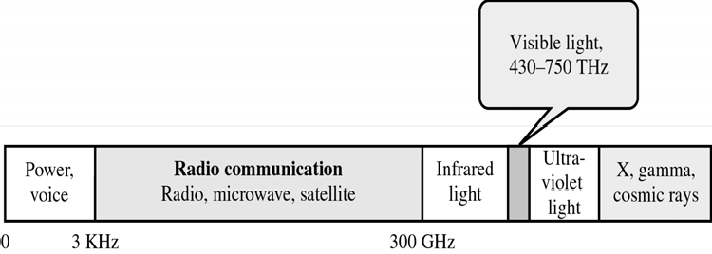
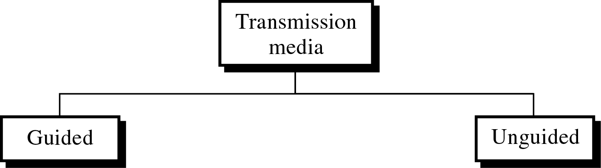
CS601-Data Communication VU
Signals are transmitted from one device to another in the form of electromagnetic energy
Electromagnetic signals can travel through Vacuum, Air or other transmission media
Electromagnetic energy, a combination of electrical and mechanical fields vibrating in relation to each other includes power, voice, video, radio waves, infrared light, visible light and ultra violet light
Each of the above constitute a portion of the Electromagnetic Spectrum:
Not all the portions of the spectrum are currently usable for Telecommunications
Voice-band frequencies are generally tx as current over metal cables, such a twisted pair or coaxial cable
Radio frequencies can travel through air or space but require specific transmitting and receiving mechanisms
Visible light, the third type of Electromagnetic energy currently used for communications is harnessed using fiber optic cable
Classes of Transmission Media
Two classes of Transmission Media:
–Guided Media
–Unguided Media
Guided Media
Guided Media, are those media that provide a conduit from one device to another

Slide 20
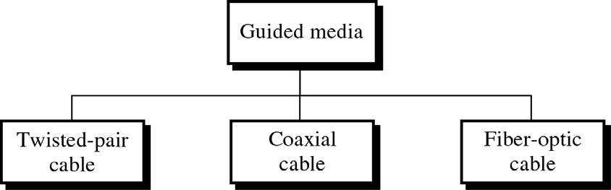
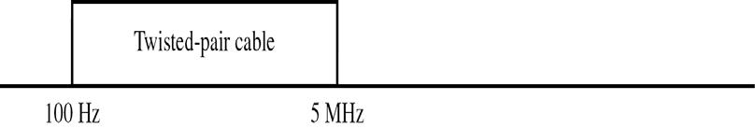
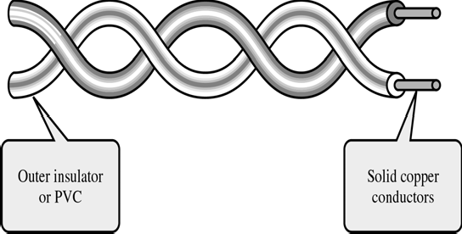
CS601-Data Communication
VU
Twisted Pair Cable
o Twisted pair comes in two forms:
–Unshielded Twisted Pair (UTP) cable
–Shielded Twisted Pair (STP) cable
Frequency range for Twisted Pair Cable
Unshielded Twisted Pair (UTP) Cable
UTP cable is the most common type of Telecommunication Medium in use today
Although mostly used in Telephone systems,, its frequency range is suitable for transmitting both data and voice
A twisted pair consists of two conductors (usually copper) , each with its own colored plastic insulation.
The plastic insulation is color banded for identification
120

Slide 21
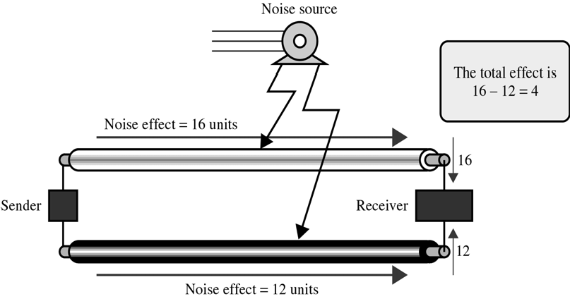
CS601-Data Communication
VU
o Colors are used both to identify the specific conductors in a cable and to indicate which wires belong in pairs and how they relate to other pairs in a large bundle
Parallel Flat Wire
In the past, two parallel flat wires were used for communication.
However, EM interference from devices such as motor can create noise over those wires
Effect of noise on Parallel Flat Wire
If the two wires are parallel, the wire closest to the source of the noise gets more interference and ends up with a higher voltage level than the wire further away
This results in an uneven load and a damaged signal
Noise Effect on Twisted-Pair
If the two wires are twisted around each other at regular intervals (b/w 2 & 12 twists per foot), each wire is closer to the noise source for half the time and is away for the other half
Twisting does not always eliminate the impact of Noise but it does significantly reduce it

Slide 22
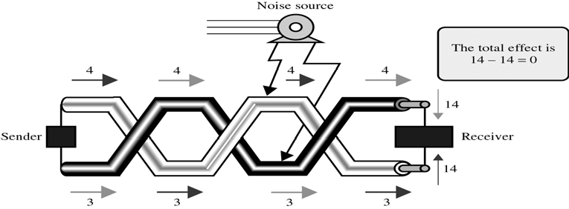
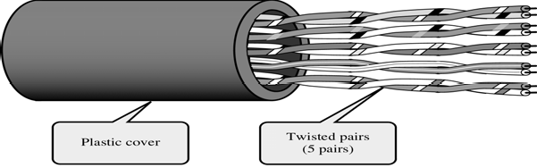
CS601-Data Communication
VU
With twisting, therefore the cumulative effect of the interference is equal on both wires
Each section of wire has a “Load” of 4 when it is on the top of the twist and ‘3’ when it is on the bottom
The total effect of the noise at the receiver is therefore 0 (14-14)
Advantage of UTP
Advantages of UTP are:
–Cost
–Ease of Use
Its cheap, flexible and easy to install
Higher grades of UTP are used in many LAN technologies including Ethernet and Token Ring
Cable with 5 UTP of wires
Categories of UTP Cable
EIA has developed standards to grade UTP cables by quality.
Categories are determined by cable quality, with 1 as the lowest and 5 as the highest
Each EIA category is suitable for certain uses and not for others
*Category 1
–Basic Twisted pair cabling used in Telephone system
–Fine for voice but inadequate for all but low-speed data communication
*Category 2

Slide 23
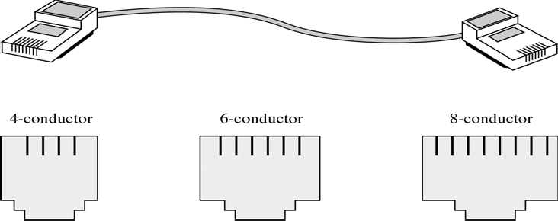
CS601-Data Communication
VU
–The next higher grade, suitable for voice and for data transmission of up to 4Mbps
*Category 3
–Required to have at least 3 twists per foot
–Can be used for for data tx ofup to 10Mbps
–Now the standard cable for most telephone lines
*Category 4
–Must have at least 3 twists per foot
–Possible tx rate of 16 Mbps
*Category 5
–Used for data transmission of up to 100 Mbps
UTP Connectors
UTP is mostly connected to the networked devices via a type of snap-in plug like that used with telephone jacks
Connectors are either male (plug) or female (the receptacle)
Male connectors snap into female connectors and have a repressible tab (key) that locks them in place
Each wire in the cable is attached to one conductor (or pin) in the connector
The most frequently used of these plugs is an RJ 45 connector with 8 conductors, one for each wire of 4 twisted pairs
Summary
Cable Modems
Electromagnetic Spectrum
Transmission Media and its Types
Guided Media
Twisted Pair
Coaxial Cable
Optical Fiber
Reading Sections
Section 6.6, 7.1, “Data Communications and Networking” 4th Edition by Behrouz
Forouzan

Slide 24
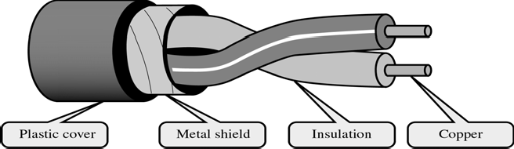
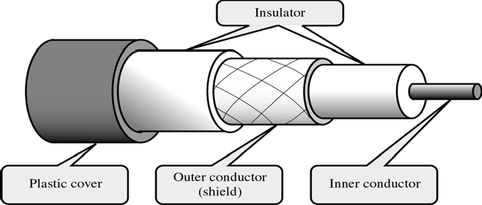
CS601-Data Communication
VU
LECTURE #25
Shielded Twisted Pair (STP)
o Has a metal foil or braided-mesh covering that encases each pair of insulated conductors
The metal casing prevents the penetration of EM noise
It also can eliminate a phenomenon called Crosstalk, which is the undesired effect of one circuit (or channel) on another circuit (or channel)
It occurs when one one line picks up some of the signals traveling down another line.
This effect can be experienced during telephone conversations when one can hear other conversations in the background
Shielding each pair of twisted pair can eliminate most crosstalk
STP Cable has the same quality considerations and uses the same connectors as UTP but the shield must be connected to a ground
STP is more expensive than UTP but is less susceptible to noise
Coaxial Cable
Instead of having two wires, coaxial cable has a central core conductor of solid or stranded wire (usually copper) enclosed in an insulating sheath
This is in turn encased in an outer conductor of metal foil, braid or a combination of the two
The outer metallic wrapping serves both as a shield against Noise and as the second conductor which completes the circuit
This outer conductor is also enclosed in an insulating sheath and the whole cable is protected by a plastic cover
Frequency Range of Coaxial Cable
Coax carries signals signals of higher frequency ranges than twisted pair cable

Slide 25
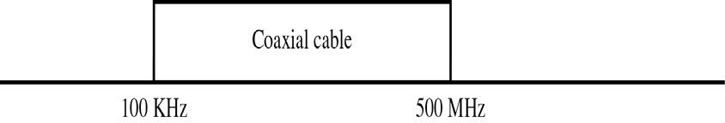
CS601-Data Communication
VU
Coaxial Cable Standards
Different coaxial cable designs are categorized by their Radio government ( RG ) ratings
Each RG number denotes a unique set of physical specifications, including
–the wire gauge of inner conductor
– the thickness and type of inner insulator
–Construction of the shield
–Size and type of outer casing
Each cable defined by RG rating is adapted for a specialized function:
*RG-8
–Used in Thick Ethernet
*RG-9
–Used in Thick Ethernet
*RG-11
–Used in Thick Ethernet
*RG-58
–Used in Thin Ethernet
*RG-59
–Used for TV
Coaxial Cable Connectors
Over the years, a no. of connectors have been designed for use with coaxial cable
Most common of the connectors is called “BARREL connector” because of its shape
Of the barrel connectors, the most popular is the Bayonet Network Connector (BNC)
BNC connector pushes on and locks into place with half turn
Other types of barrel connectors either screw together and so require more effort to install or push on w/o locking which is less secure
Coaxial cables are familiar in Cable TV and VCR hookups that employ both threaded and alip on style
Two other commonly used connectors are T-connectors and Terminators
*A T-connector (used in Thin Ethernet) allows a secondary cable or cables to branch off from a main line
*Terminators are required for bus topologies where one main cable acts as a backbone with branches to several devices but does not itself terminate in a device

Slide 26
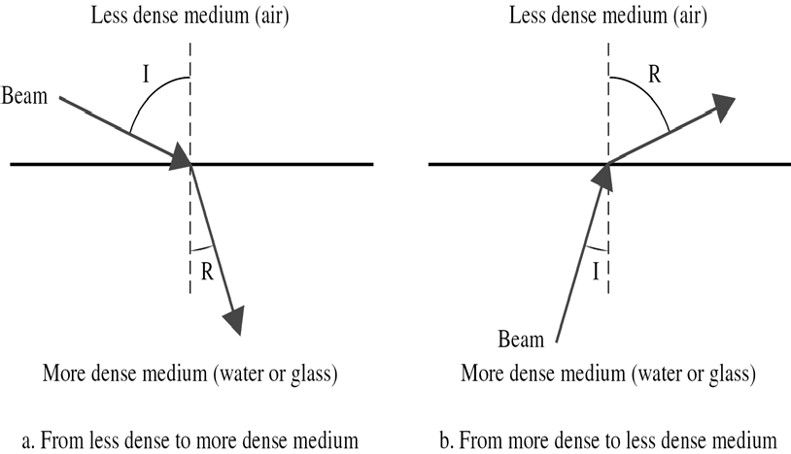
CS601-Data Communication
VU
If main cable is left un terminated, any signal tx over the line echoes back and interferes with the original signal
A terminated absorbs the wave at the end and eliminates this echo
Optical Fiber
Until this point we have discussed conductive (metal) cables that transmit signals in the form of current
*Optical fiber is made of glass or plastic
*It transmits signals in the form of light
The Nature of Light
The speed of light
–300,000 Km/sec in a vacuum
–Depends on the density of the medium through which it is traveling
–The higher the density, the slower the speed
Refraction
Light travels in a straight line as long as it is moving through a single uniform structure
If a ray of light traveling through one substance enters another (more or less dense) substance, its speed changes abruptly causing the ray to change direction
This phenomenon is called Refraction
Example of Refraction
o A pencil sticking out of a glass of water appears bent because the light by which we see it changes direction as it moves from air to water
Direction of Refraction
Direction in which a light is refracted depends upon the density of a medium
A beam of light moves from a less dense into a more dense medium bend towards vertical axis
Incident angle is ‘I’ and Refracted angle is ‘R’

Slide 27
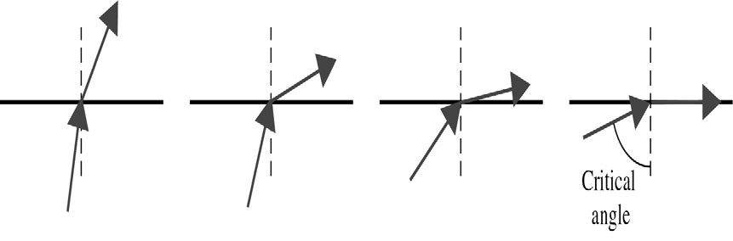
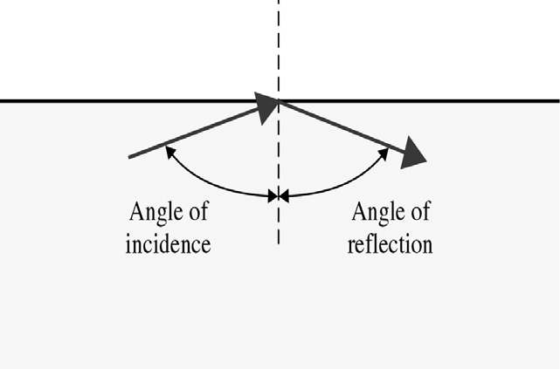
CS601-Data Communication
VU
Critical Angle
We have a beam of light moving from a more dense to a less dense medium
We gradually increase the angle of incidence measured from vertical axis
As angle of incidence increases, so does the angle of refraction
The angle at which refracted line lies on the horizontal axis is called
Critical Angle
Reflection
When angle of incidence becomes greater than critical angle, reflection occurs
Light no longer passes into the less denser medium but is reflected back into the same medium
The Angle of Incidence (I) = Angle of Reflection (R)
Optical Fibers & Reflection
Optical fibers use Reflection to guide light through a channel
A glass or plastic CORE is surrounded by a CLADDING of less dense glass or plastic
The difference in the density of CORE and CLADDING is such that the beam of light moving through the core is reflected off the cladding
Information is encoded onto a beam of light as a series of ON-OFF flashes that represent 1 and 0 bits

Slide 28
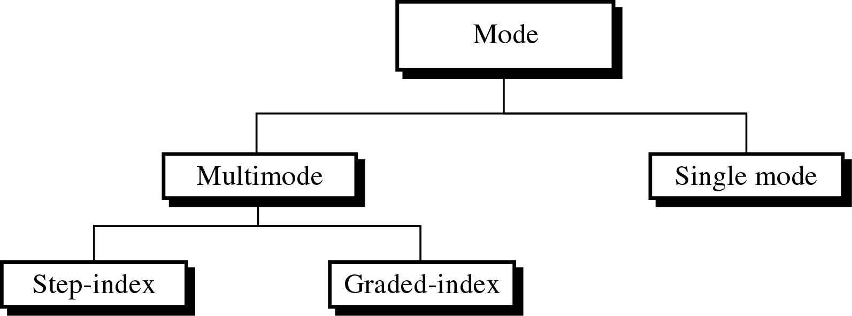
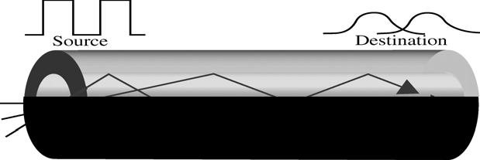

CS601-Data Communication
VU
Propagation Modes
Fiber Technology supports two modes for the propagation of light
Multimode
Single Mode
Each of these modes require fiber with different physical characteristics
There are two further sub categories of Multimode Fiber:
Multimode Step-Index Fiber
Multimode Graded-Index Fiber
Multimode Fiber
Multiple beams from a light source move through the core in different paths
Two types of the Multimode fiber:
Multimode Step Index Fiber
Multimode Graded Index Fiber
Multimode Step-Index Fiber
Density of the CORE remains constant from the center to the edges
A beam of light moves through this constant density in a straight line until it reaches the interface of the core and the cladding
At the interface, there is an abrupt change to lower density, that alters the angle of the beam’s motion
Step Index€ Suddenness of this change
Some beams travel straight and reach the destination without reflecting
Some strike the interface of core and cladding at an angle smaller than critical angle and penetrate cladding and are lost

Slide 29
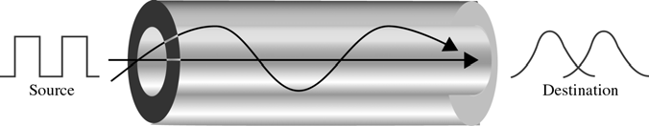
CS601-Data Communication VU
Others hit edge of the core at angles greater than critical angle and bounce back and forth to the destination
Disadvantage of Multimode Step-Index Fiber
Each beams angle is equal to its angle of reflection
If I is small, R is small and the beam will require more bounces and it will take more time to reach the destination
If I is large, R is large and beam will reach destination quickly
In other words there is a difference is Path Lengths that results into a distortion at the receiver
This distortion limits the data rate and make Multimode Step index fiber inadequate for precise applications
Multimode Graded-Index Fiber
The solution to the above problem is Multimode Graded Index Fiber
A grade index fiber is the one with varying densities
Density is highest at the center of the core and decreases gradually to its lowest at the edge
The signal is introduced at the center of the core
The horiz beams move straight to the receiver
Beams at other angles moves through the series of constantly changing densities
Each density difference causes each beam to refract into a curve
Signal can be reconstructed with far greater precision as all the beams reach the receiver at almost the same time
Summary
Transmission Media and its Types
Guided Media
Twisted Pair
Coaxial Cable
Optical Fiber
Reading Sections
Section 7.1, “Data Communications and Networking” 4th Edition by Behrouz A. Forouzan

